Slide 1
HR Analytics Hackathon
Model Performance Comparison (F1 Score)
Logistic Regression(Tuned with best parameter): F1 = 0.37
Decision Tree(Tuned with best parameter): F1 = 0.42
Random Forest (Tuned with best parameter): F1 =0.47
Ada Boosting = 0.24 - Not giving best result with tuning also
Gradient Boosting (Tuned with best parameter ): F1 = 0.49
Gradient Boosting (Tuned with best parameter and probability threshold ): F1 = 0.51
XGBoost (Tuned + best Threshold): F1 = 0.49
Notebook Link: Ani-123-design/GoogleColabNotebook
Gradient Boosting achieved the highest F1 score among all evaluated models
Final GradientBoost model was pickled and deployed via:
FastAPI Link (real-time REST API) - Ani-123-design/Repo_Fast_API_Hackathon
Streamlit UI (interactive web application) -Ani-123-design/hackathon_inceptez_Ds_25
R Anirudh Srinivas

Slide 2
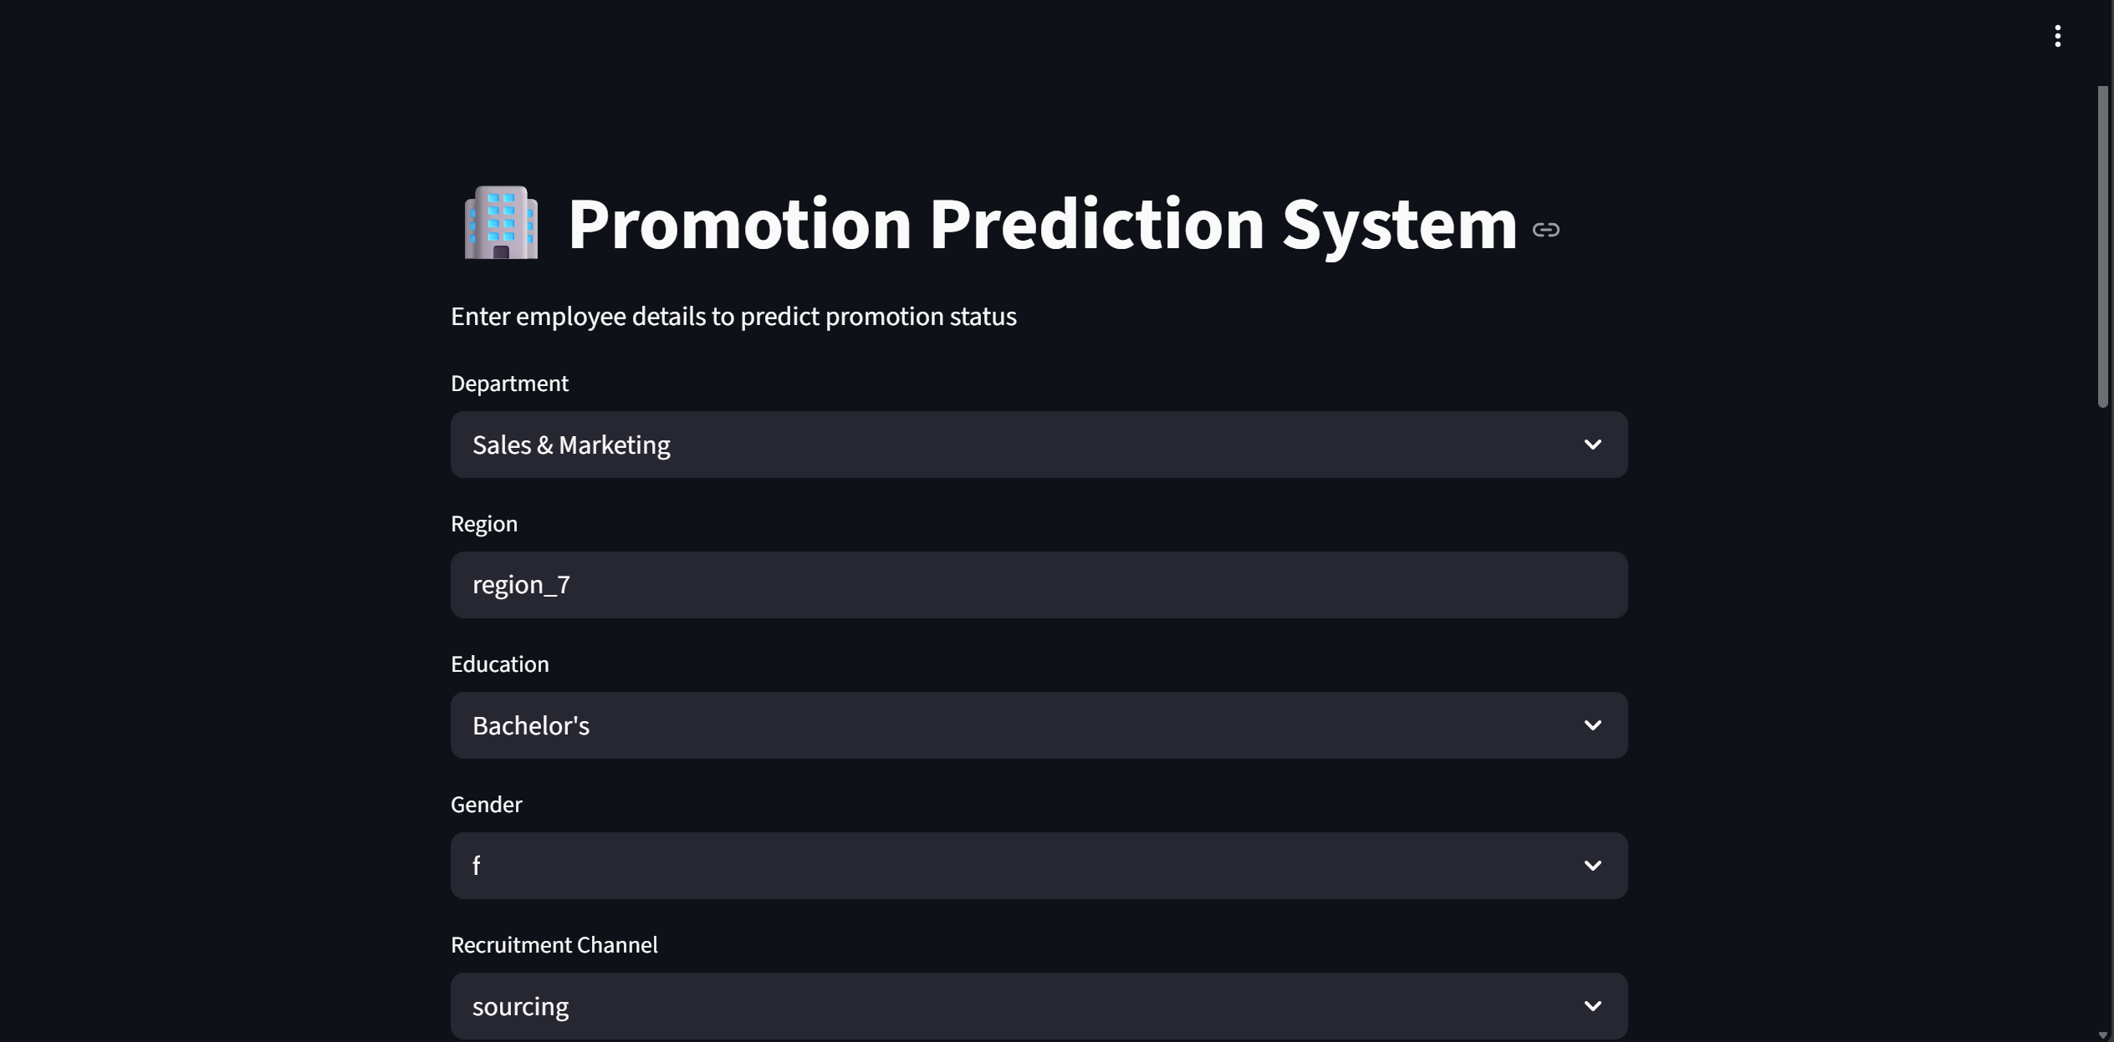
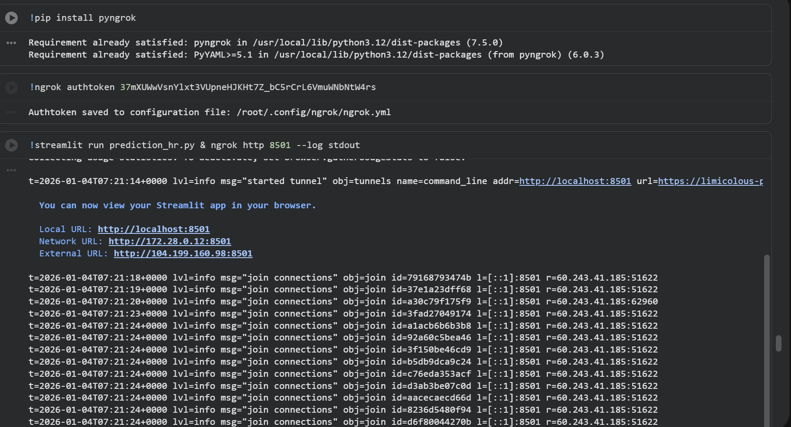
STREAMLIT APP - LOCAL

Slide 3
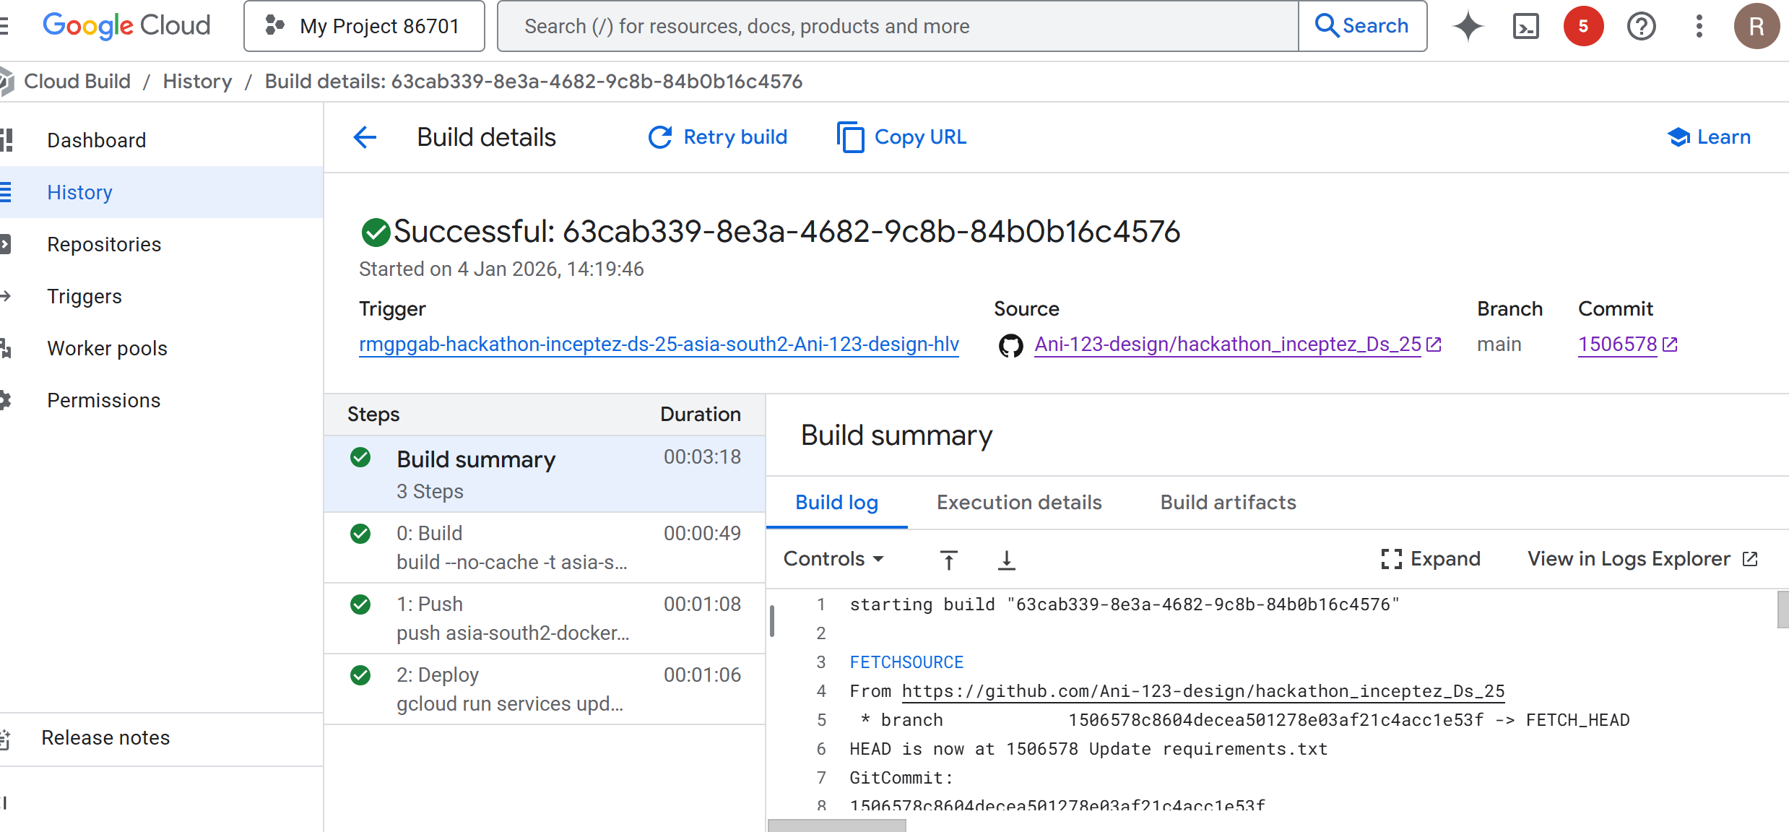
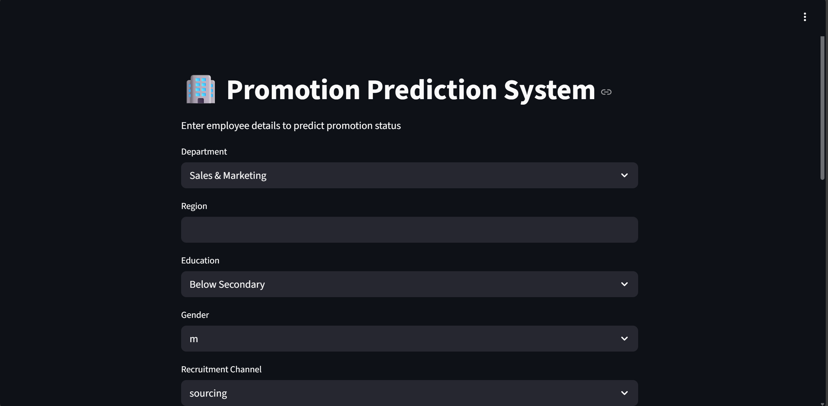
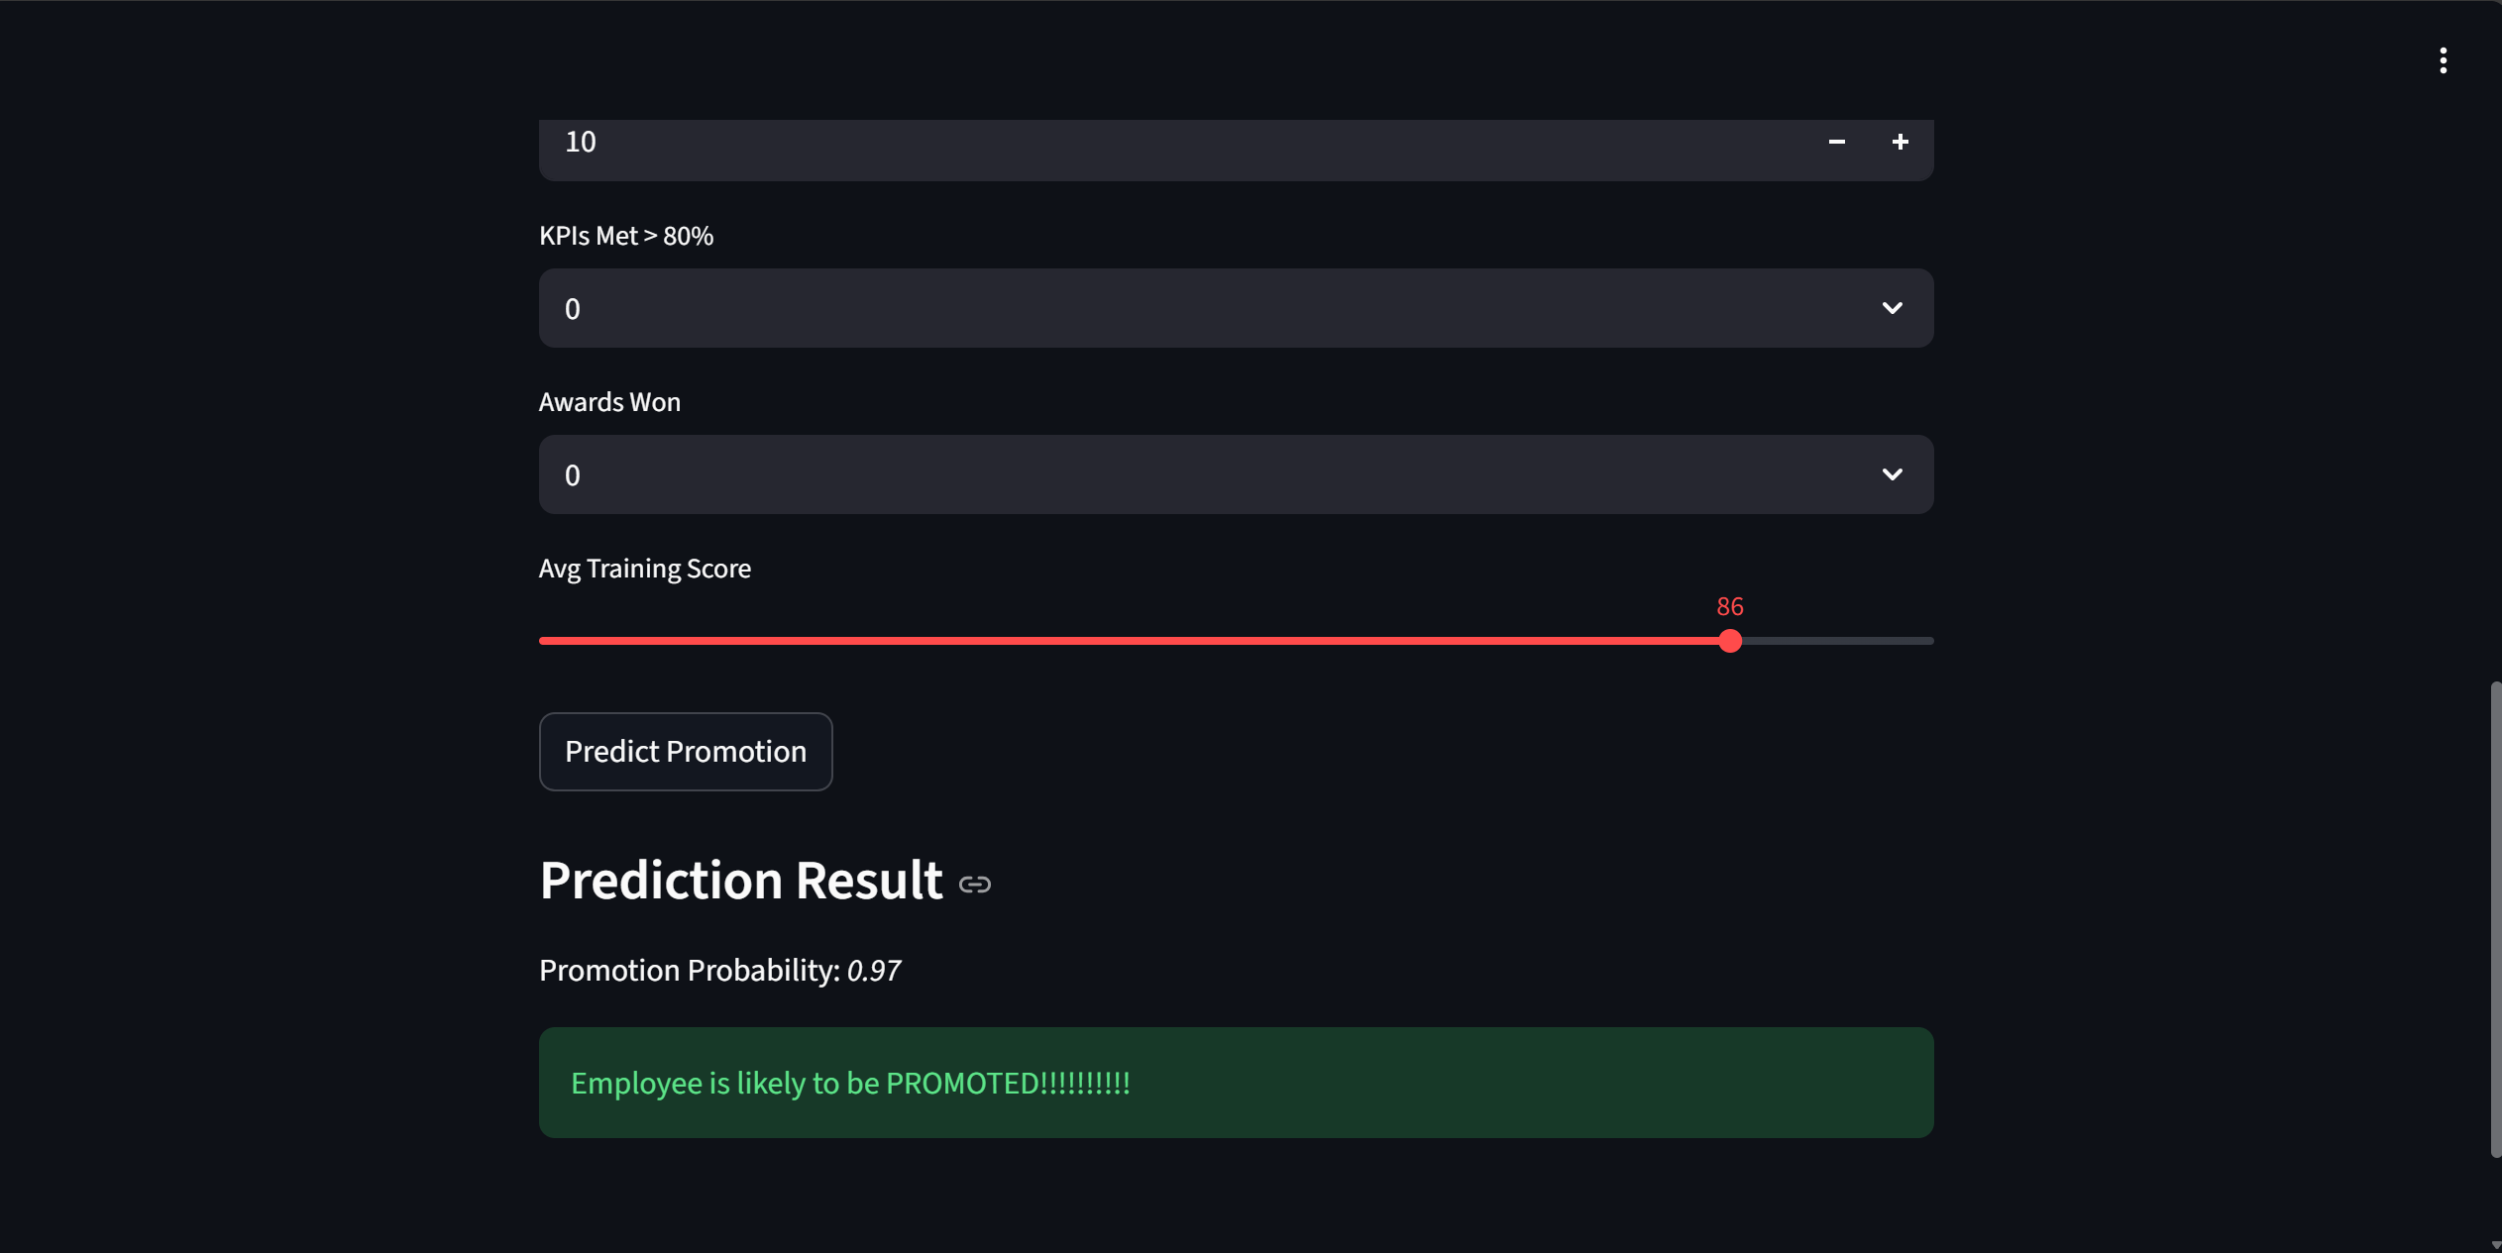
STREAMLIT - GCP

Slide 4
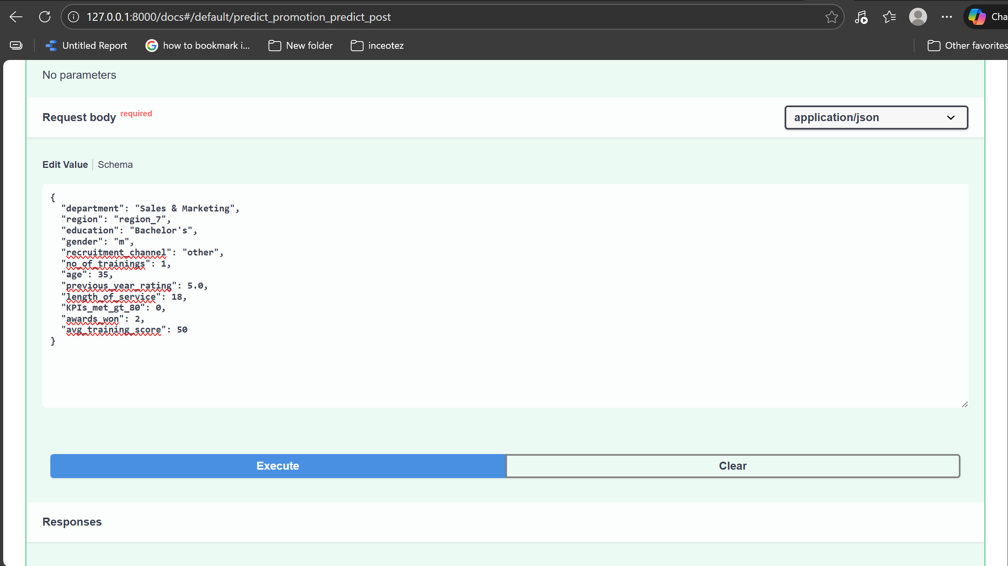
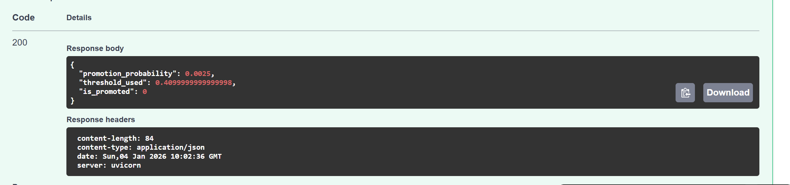
FastAPI - LOCAL

Slide 5
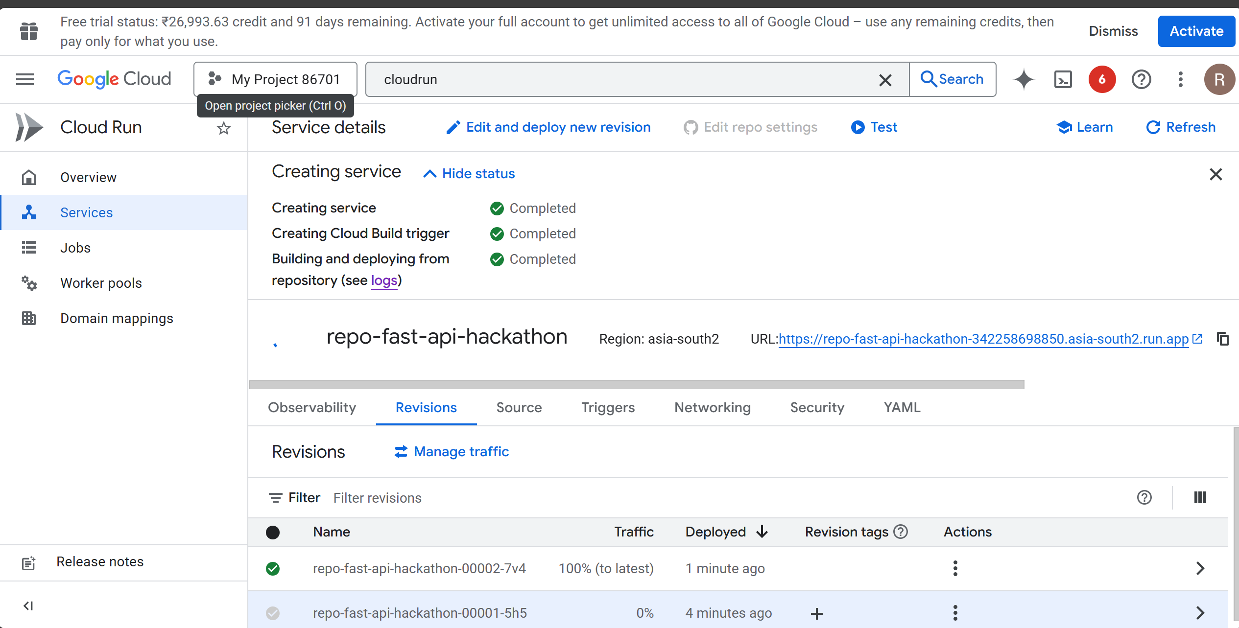
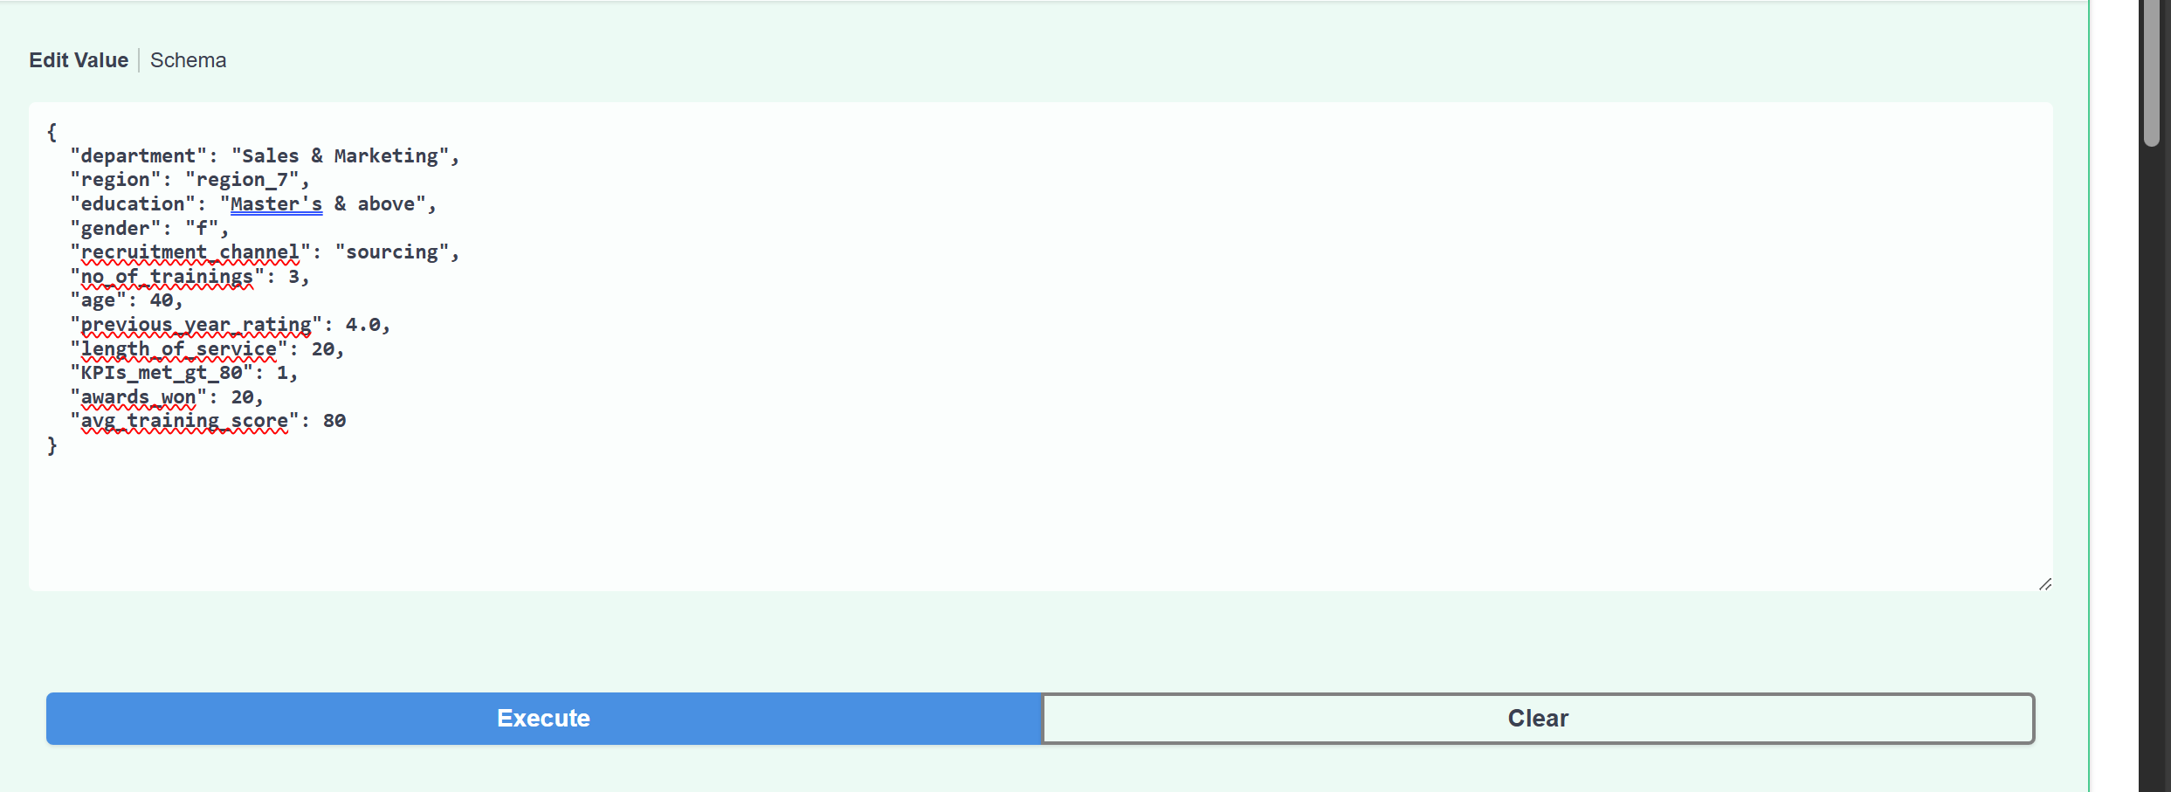
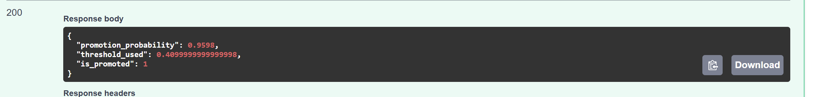
FastAPI - GCP

Slide 6
THANK YOU!!!!!

